Slide 1


Negotiation and Conflict Management
Lecture 10
MGMT-3105

Slide 2

Negotiation and the project manager
As a Project Manager your daily activities will frequently involve negotiation. These negotiations will be conducted internal and external to the organization. You will negotiate for or with:
Resources
Material
Time
Equipment
Money
Contractors
Costs
Delivery Schedules
Quality of Material
Hours of Work
Department Managers
Manpower
Schedules

Slide 3
Negotiation Fundamentals of your Mindset
Separate the people from the problem.
All of us have egos. All of us have fears and insecurities. Don't tap into the other guys’. You will throw both sides of the negotiation out of control.
Stick to business.
Keep the personalities out of it. This is not the time for a charm offensive. Nobody will buy it.
Put yourself in their shoes.
Nobody likes to be directly attacked. This is an extremely ineffective strategy can is usually counter-productive.

Slide 4
Negotiation – The basics in getting ready
Negotiations are win-win or no win.
Talk money last if possible.
Negotiations always begin well in advance of the actual discussions.
The most important thing to know about any negotiation you go into is what the other side wants and how to give it to them. You already know what you want.
Negotiations are not just about the money. They are about the complete compensation package.

Slide 5
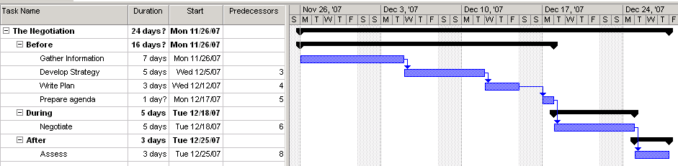
Negotiation – The basics in getting ready
There are 3 stages in the negotiation process: Before, During, and After.
Before always should be the biggest stage.

Slide 6

Gather Information about the other side
Vital interests
Goals, costs, strategies, positions, needs
Product strengths
Concession patterns- are they predictable?
Tactics – what has been their negotiating style previously
Bottom line- what do they have to agree?
Corporate deadlines and time constraints
Budget – how much can they afford?
Geographic limitations
Also know your company’s position, the players in the negotiation, and who holds the power. Note that people behind the scenes hold influence.

Slide 7
Develop Strategy
Aim high. Aim for more than one possible scenario that is win-win.
Be realistic.
Arrange your objectives by priority.
Know your bottom line.
Are deadlock or termination options for you in the negotiation? Are they tolerable outcomes?
Which items are necessary and which items are expendable for you?
Have several red herrings available.
Have an idea how you are going to help the other side negotiate within their organization.
Determine where your interests and the other side's interests intersect.
Anticipate and brainstorm what questions you might be asked and how to potentially deal with them.

Slide 8
Write your Negotiation Plan and Prepare an Agenda
Your plan includes:
your interests, the interests you expect the other side to have,
your desired outcomes, your estimates of the other sides desired outcomes,
your authority limits in relation to possible outcomes, the other sides authority limits in relation to possible outcomes,
any additional information either you or the other side might require such as a fact sheet.
Your agenda includes:
The goal of the meeting
Published in advance (if to your advantage duration of the meeting).
The invitees
The meeting location

Slide 9
Negotiations - Questions
When entering a negotiation, every negotiator needs to ask themselves 3 questions:
How much power do I have?
What sort of time pressures are there?
Do I trust my opponent?

Slide 10
Negotiation - Questions
Question: Who controls a conversation, generally?
Answer: Generally, the person asking the questions, because they control the direction of the conversation. You want to ask most of the questions in any negotiation regardless of your relative positions.
For example, when negotiating your salary.
Remember also that people are conditioned from birth to answer questions. They will provide useful information in a negotiation if you can think quickly regarding what to do next with what you are handed.
One way or another though, you need to politely try to gain the advantage of directing the discussion. It is a key to your success. Just knowing when your counterpart is doing it to you is empowering as well.
So be patient. You will get your turn.

Slide 11
Negotiations Advanced questioning techniques
Generally people resist being interrogated, so if you are going to ask most of the questions, remember the negotiations must conclude in a win-win situation. This implies that some of your questions may need to be rhetorical or provide advantage to the other side. Keep this in mind, or you will lose control of the questioning.
One technique, which is effective but dangerous, is the concept of asking a series of rhetorical questions that provide the same yes or no answer. If asked quickly, politely, and professionally, they can be a useful technique:
Are you available at that time?
And is the equipment available at that time?
And are the workers available at that time?
How about supervision?
Then perhaps we should consider moving the paint line on Saturday.

Slide 12
Negotiation Language and Communication
Sample Statements:
When you want to establish your power early in the negotiation:
"I'm sorry, but my colleagues and I cannot settle for that."
When you want to invoke the power of legitimacy:
"It doesn't apply in this case." or “That has never been the standard for this type of application."
When you want the other party to state their opening position:
"What are you looking for in these negotiations?"
When you want to find out how much authority the other party has:
"Do you have the authority to commit to that without checking it out at head office?"
When you don't want to say no outright for fear of breaking down discussions:
"Let's set that aside for now. Let’s come back to it."

Slide 13
Negotiation Language and Communication
When you want to sound a little incompetent:
"I get these things confused. Is this what we just agreed upon?"
When you want to buy time and apply pressure:
"Let me take that to my director. I'll be right back."
When you want to propose instead of demand:
"May I suggest this alternative?"
When you want to appease the other party:
"Good point. I'm glad you asked that."
When you want the other party to save face:
"I absolutely cannot budge on price, but here is what I can do..."
When you want to uncover the other side's needs:
"What do you think?" "What would you like to see happen?"

Slide 14
Negotiation Not the words, but what they are saying
"To tell you the truth..." (lying)
"To be brutally honest..." (lying)
"Off the record..." (nothing is ever off the record. The negotiation is always on.)
"Just between you and I...." (a secret is something you tell only one other person. Think about it)
"I'd love to, but....." (no they wouldn't)
"Oh, before I forget..." (Listen carefully to what comes next, that is set up lingo)
CONGRUENCE: When a person's words and body gestures are in sync, there is congruence. When they are out of sink, the listener will, often sub-consciously, interpret the meaning of the communication based upon non-verbal signals and body language.

Slide 15
Conflict Management

Slide 16

Conflict Management
Conflict is a process that begins when you perceive that someone has frustrated or is about to frustrate a major concern of yours.
Conflict contains a dynamic aspect. Conflicts evolve.
Further, the causes of a conflict may change over time. The original reason why two individuals or groups developed a conflict initially may no longer have any validity – but they are still stuck in conflict.
Because conflict is dynamic and evolving, once a conflict has occurred, the reasons behind it may no longer matter.
Conflict is perceptual in nature. In other words, it doesn't really matter if one party wronged the other or not, so long as one party perceives the wronging to have occurred.

Slide 17

A) Goal-Oriented Conflict
This type of conflict is associated with:
disagreements regarding end results desired
project scope outcomes
performance specifications and criteria
project priorities and objectives
It is fueled by vague or incomplete goals that allow project members to make their own interpretations.
Often this type of conflict brings to light the hidden agenda that individual team members might have regarding their role in the project and how they perceive their ideal role in the work ahead.

Slide 18

B) Administrative Conflict
This type of conflict is associated with:
management hierarchy
organizational structure
company philosophy
They often center on who has authority or administrative control for functions, project tasks, and decisions.
Matrix organizational structures frequently breed this type of conflict since each team member has two bosses.

Slide 19
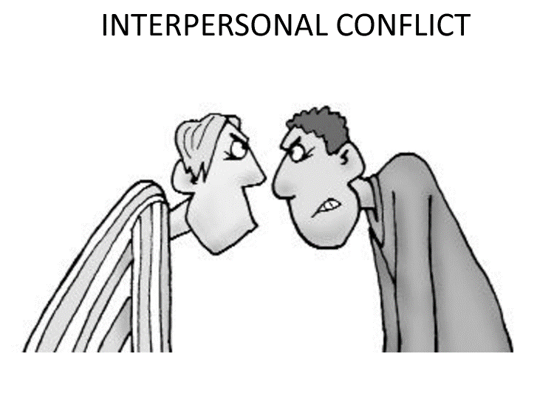
C) Interpersonal Conflict
These types of conflicts are associated with personality differences among project team members or may even involve other stakeholders.
Interpersonal conflict sources include:
different work ethics
different behavioral styles
egos
personalities that do not mesh easily

Slide 20
How Conflict is Perceived and Addressed
There are three project management schools of thought regarding conflict. They are:
Traditional (no conflict should be supported)
Behavioral (some is accepted, if inevitable)
Interactionist (limited amount of conflict is supported)
These 3 schools of thought vary dramatically in terms of how they view conflict, and how it should be dealt with.

Slide 21
1. The Traditional View of Conflict
The Traditionalist view of conflict is to view it as having a negative effect on organizations.
Those that adhere to this theory perceive all conflict to be bad. They believe that when conflict occurs it should be resolved as quickly and painlessly as possible.
The emphasis of traditionalists is conflict suppression and elimination.
This type of conflict management can have a very strong cultural bias. Japanese business practices frequently promote this type of conflict resolution where saving face is a prime consideration.

Slide 22
2. The Behavioral View of Conflict
Behaviorists regard conflict as a natural and an inevitable part of organizational life.
Different points of view among functional departments including their having differing goals, attitudes, and beliefs are natural and permanent states among members of a company.
Behaviorists' solution for conflict is to accept it and manage it effectively rather than try to eliminate or suppress it.

Slide 23
3. The Interactionist View of Conflict
Interactionists, like behaviorists, believe that conflict is inevitable.
However, interactionists see conflict as a benefit to an organization, and actually encourage a controlled amount of it to develop.
Conflict in this view is seen to prevent an organization from becoming stagnant
Conflict is theorized to introduce an element of tension that produces innovation, creativity, and higher productivity.
Interactionists see a balance in conflict being required where too little leads to inertia and too much leads to chaos.

Slide 24
Sources of Conflict in a Project
Project conflict arises out of multiple sources including but not limited to:
violations of group or organizational norms
disagreement over project goals
personal slights
threats to job security
ambition and ego
etc...........
These can generally be summarized by dividing them into 2 separate types:
Organizational causes
Interpersonal causes

Slide 25
Organizational Causes of Conflict
Some of the more common causes of organizational conflict include:
Reward systems
Scarce resources
Uncertainty
Different mind sets among departments

Slide 26
a) Organizational Causes of Conflict – Reward Systems
Reward systems are competitive processes some organizations have set up that pit one group or functional department against another.
As an example, when functional managers are evaluated on the performance of their sub-ordinates within the department, they are loath to allow their best workers to become involved in project work for any length of time. In these cases typically the functional manager reserves his best workers for department work and makes his lesser performers available for project work.
This also creates a justifiable tension between the project manager and the functional manger whom he perceives as putting his interests ahead of the organization.

Slide 27
B) Organizational Causes of Conflict – Scarce Resources
Organizations are typically characterized by several different groups vying for access to the same resources at any given time.
If scarce resources are the natural state within organizations, groups will be in conflict as they seek to gain an advantage in their distribution.

Slide 28
C) Organizational Causes of Conflict - Uncertainty
In the project environment of a weak matrix company, it is easy to see how it can be unclear who may be in charge of any task as the lines for the formal channels of authority are blurred.
Project managers and their teams can find themselves in the fragile position of having a lot of autonomy, but also responsibility to the functional heads that provide the resources.
Generally, when an employee is in this state of organizational conflict, the employee will most likely side with the 1 of the 2 nominal "bosses" he or she has that has "power of the performance appraisal". In other words, the one who has the greatest immediate impact on the employee's pay cheque.

Slide 29
D) Organizational Causes of Conflict -Different mind sets among departments-
Different mind sets develop among different functional departments because they have different primary interests. Marketing cares about sales, finance cares about margins, R&D cares about the product content etc.;
What is interesting is that typically new members of a functional group adopt the attitudes and outlook prevailing within the group. Thus, if there are biases against finance as "bean-counters", or R&D guys as being unlimited in their desire to add cost via product features, these prevailing attitudes are perpetuated.

Slide 30
Interpersonal Causes of Conflict
Some of the more common causes of interpersonal conflict include:
Misconceptions regarding the behavior of others
Faulty communication
Personal grudges

Slide 31
E) Interpersonal Causes of Conflict -misconceptions regarding the behavior of others
When people perceive their interests have been thwarted by another individual or group, they can sometimes suspect a hidden agenda or personal vendetta.
Sometimes it is paranoia, and sometimes it is not. Often people will think that others are simply doing what is most politically or personally expedient for them.
Sometimes the position is "he or she doesn't like me, or he or she doesn't understand". This is often used as a defense mechanism when people cannot see that 2 reasonable people can look at the same situation and draw different conclusions.
Most of us like this safe defense mechanism because it allows us to not challenge ourselves with the possibility that others might be correct and there could be a flaw in our logic.
People with weak egos most often fall into this trap.

Slide 32
F) Interpersonal Causes of Conflict -Faulty Communication
This conflict is often caused by communicating in a manner that is ambiguous, resulting in different interpretations.
It can also be caused by differing values related to unintentionally communicating in ways that anger or annoy other parties.
E.g. Some team members can handle tough love type conversations and respond with improved performance. Others will see it as destructive or unfair. It is important to note that in this case it is not so much the content of the communication as the style.

Slide 33
G) Interpersonal Causes of Conflict -personal grudges
These attitudes arise out of long-term experiences or lessons taught at some time in the past.
Often these attitudes can be sub-consciously held.

Slide 34
Sources of Conflicts in Projects and their Ranking by Intensity Level
In order below, based upon data from PMBOK, are the most common
sources of project conflict:
schedules
project priorities
resources
technical opinions
administrative procedures
cost
personality
Many project managers think that personality is the main cause of
conflict on projects. It only becomes personal when the root cause
of the conflict is not resolved. Personality is very frequently the first diagnosis.

Slide 35
Methods of Conflict Resolution
As published in PMBOK, the main problem-solving techniques for conflict resolution in project management are:
Confronting (Solving the real problem)
Compromising (Finding solutions that bring some degree of satisfaction to both parties)
Withdrawal or Avoidance (Retreating or Postponing a decision)
Smoothing (Emphasizing areas of agreement rather than differences of opinion)
Forcing (Pushing one viewpoint at the expense of another)

Slide 36
Conflict Example 1
Reward systems
Scarce resources
Uncertainty
Different mind sets among departments
Misconceptions regarding the behavior of others
Faulty communication
Personal grudges
Which cause of conflict could each of the following statements indicate?
“I can’t talk to her after what her son said to my son.”
“The sales management at this company are lazy. They always leave the office by 4:00.”
“She barely looked at my report. She has probably already decided to ignore it.”
“Our computers are too slow because their division always gets the best computers.”
“The worse your project performs at the end of the year, the better my project looks”
“Everybody else knew to submit that report. Why didn’t you?”
“Why should I do that for my project manager if my functional manager didn’t tell me?”

Slide 37
Conflict Example 2
Suppose the maintenance supervisors working on your project didn’t come to the first two morning meetings. How could this be an indication of any of the following causes of conflict?
Organizational
Rewards Systems
Scarce Resources
Uncertainty
Different Mindsets
Interpersonal
Misconceptions
Faulty Communications
Personal Grudges

